Slide 1



Rain Gardens:
A Simple Way to Do Your Part
A Quick Commercial from the Rutgers Cooperative Extension Water Resources Program
E-mail: obropta@envsci.rutgers.edu
www.water.rutgers.edu

Slide 2

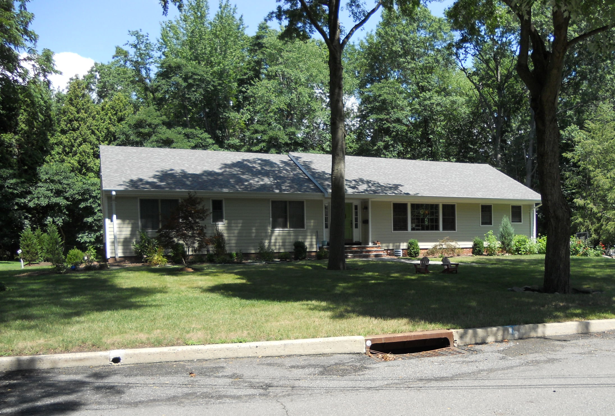

Keep the Rain from the Drain
Notes:
This rooftop is directly connected to the street. The rooftop runoff flows to the road to the catch basin to the stream. This rooftop is directly connected to the stream.

Slide 3
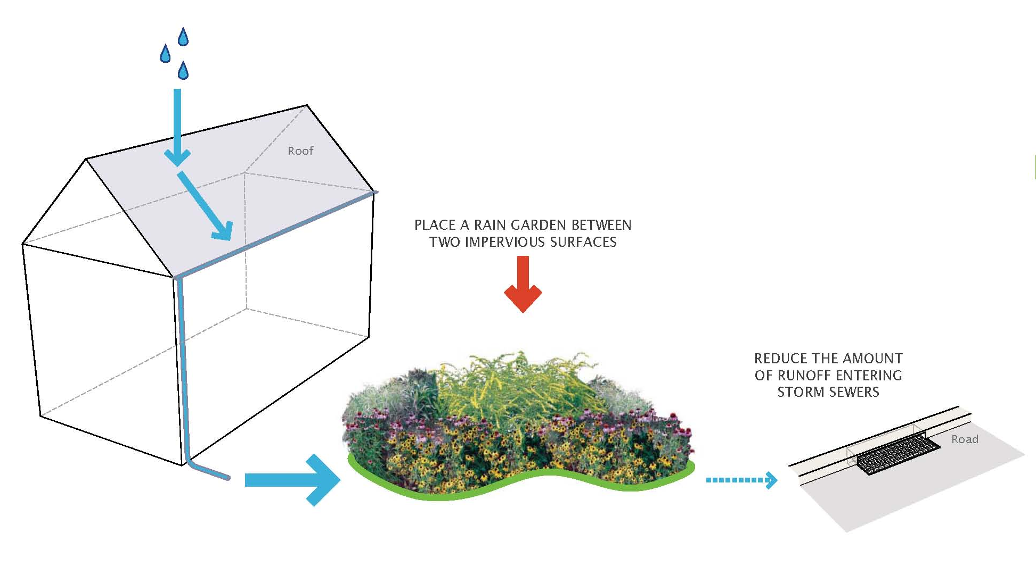
Disconnect with a Rain Garden
Notes:
Disconnect the rooftop to a rain garden.

Slide 4
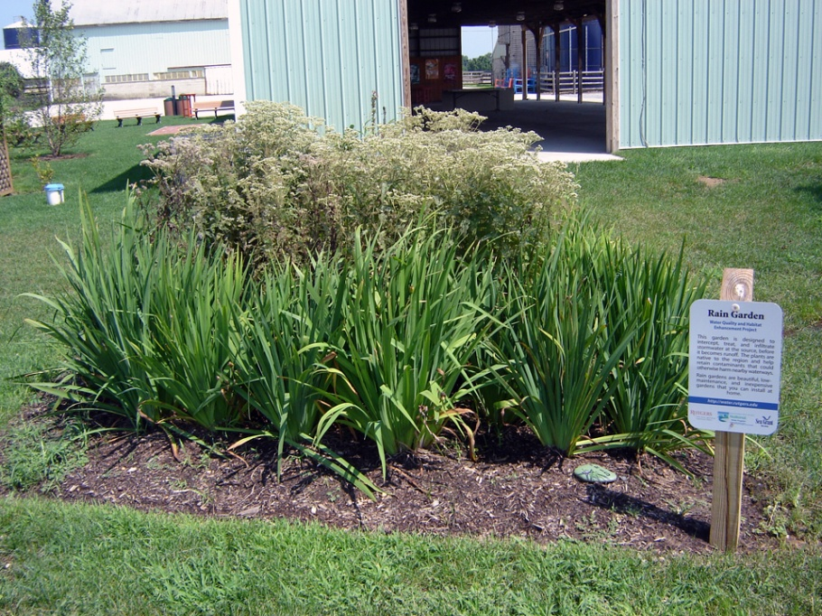
Rain Gardens
A rain garden is a landscaped, shallow depression that is designed to capture, treat, and infiltrate stormwater at the source before it becomes runoff.
Notes:
What is a rain garden?

Slide 5

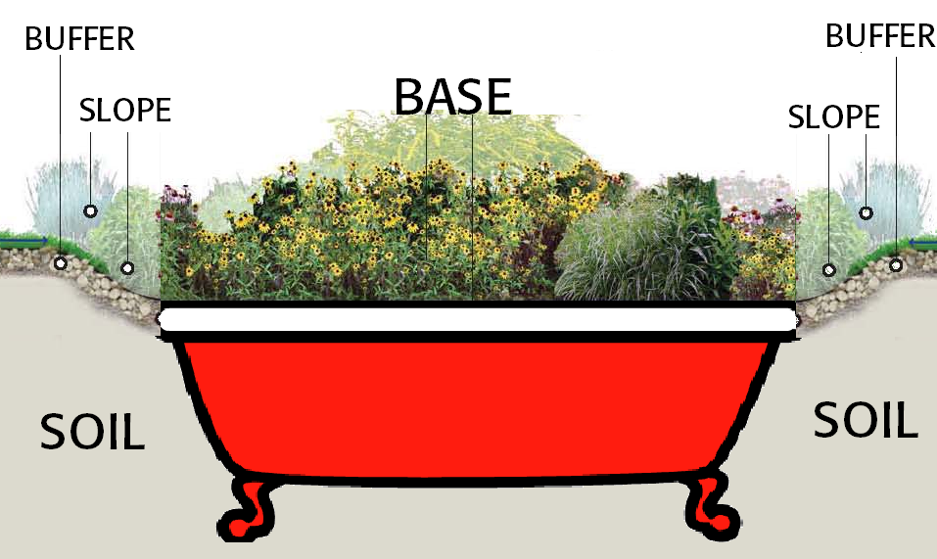

Parts of a Rain Garden
Notes:
5
A rain garden has a flat bottom and fills up with stormwater runoff that slowly seeps into the soil.
5

Slide 6
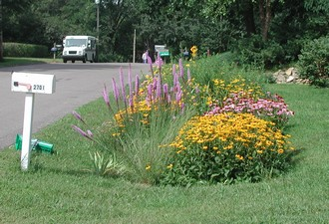
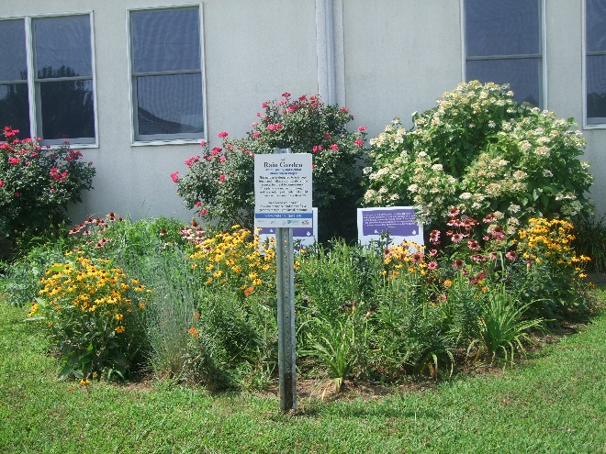
Rain Gardens
  Landscaped areas that treat stormwater runoff
  Designed to merge two important goals: aesthetics and water quality
  Can be blended into the landscape and made to look natural
  Water is directed into them by pipes, swales, or curb openings
Notes:
More about rain gardens.

Slide 7
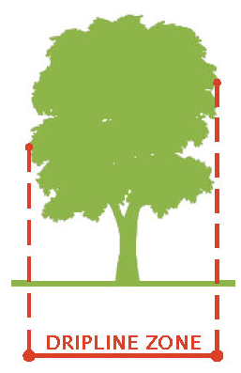
Site Selection
Next to a building with a basement, rain garden should be located at a minimum of 10′ from building; no basement, 2′ from building
Do not place rain garden within 25′ of a septic system
Do not situate rain garden in soggy places where water already ponds
Avoid seasonably-high water tables within 2′ of rain garden depth
Consider flat areas first – easier digging
Avoid placing rain garden within dripline of trees
Provide adequate space for rain garden
Notes:
Siting considerations.

Slide 8
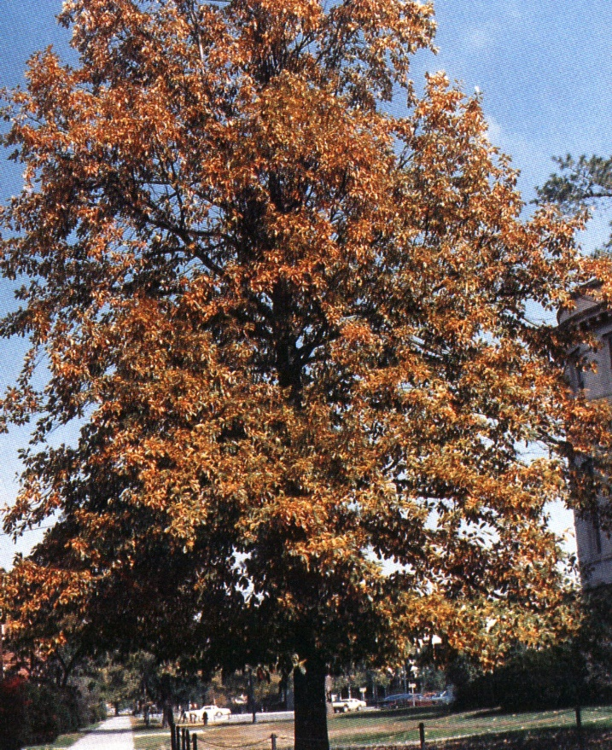
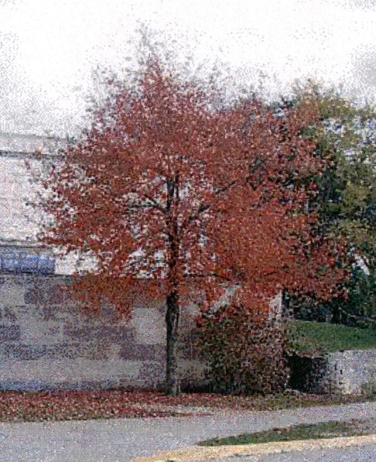
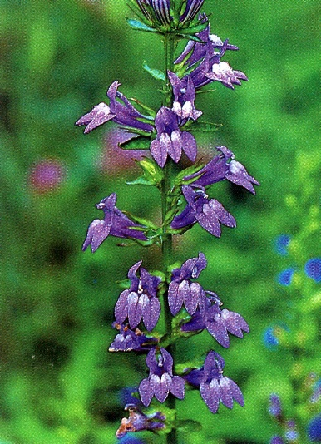
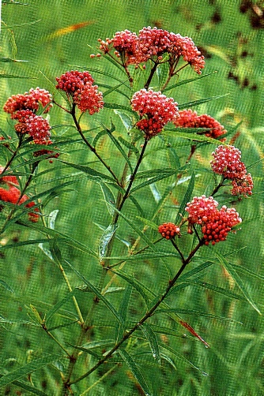

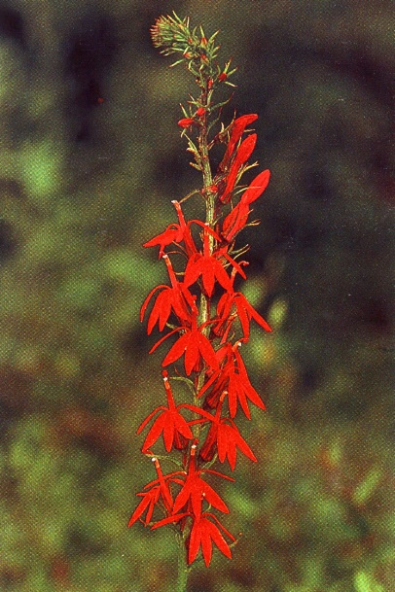
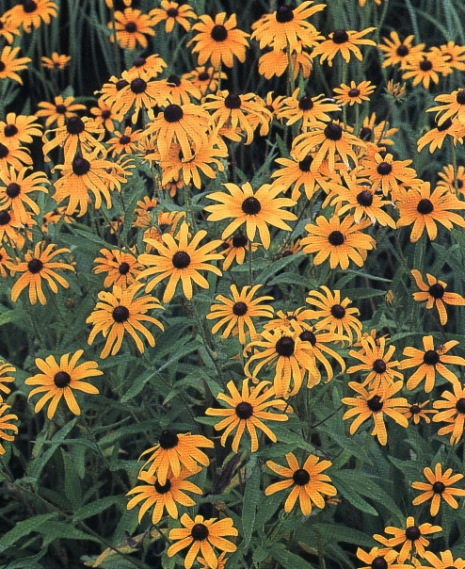
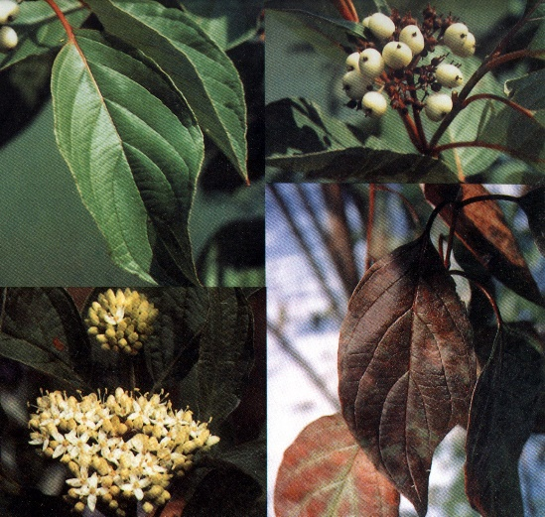
Native Vegetation
Notes:
We plant our rain garden with native plants.

Slide 9
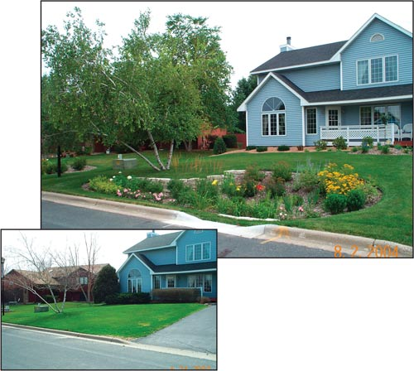
Notes:
The Blue House Picture. Before and after a roadside rain garden. Talk about increasing property value!

Slide 10
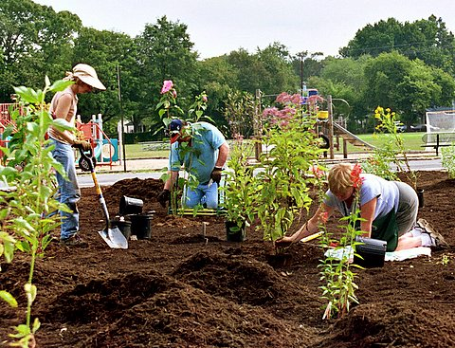
Notes:
Volunteers building a rain garden at elementary school in Cranford, NJ

Slide 11
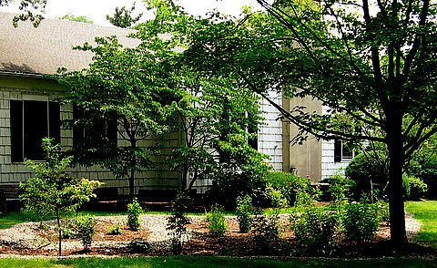
Notes:
Beautiful rain garden at the Fanwood Public Library

Slide 12
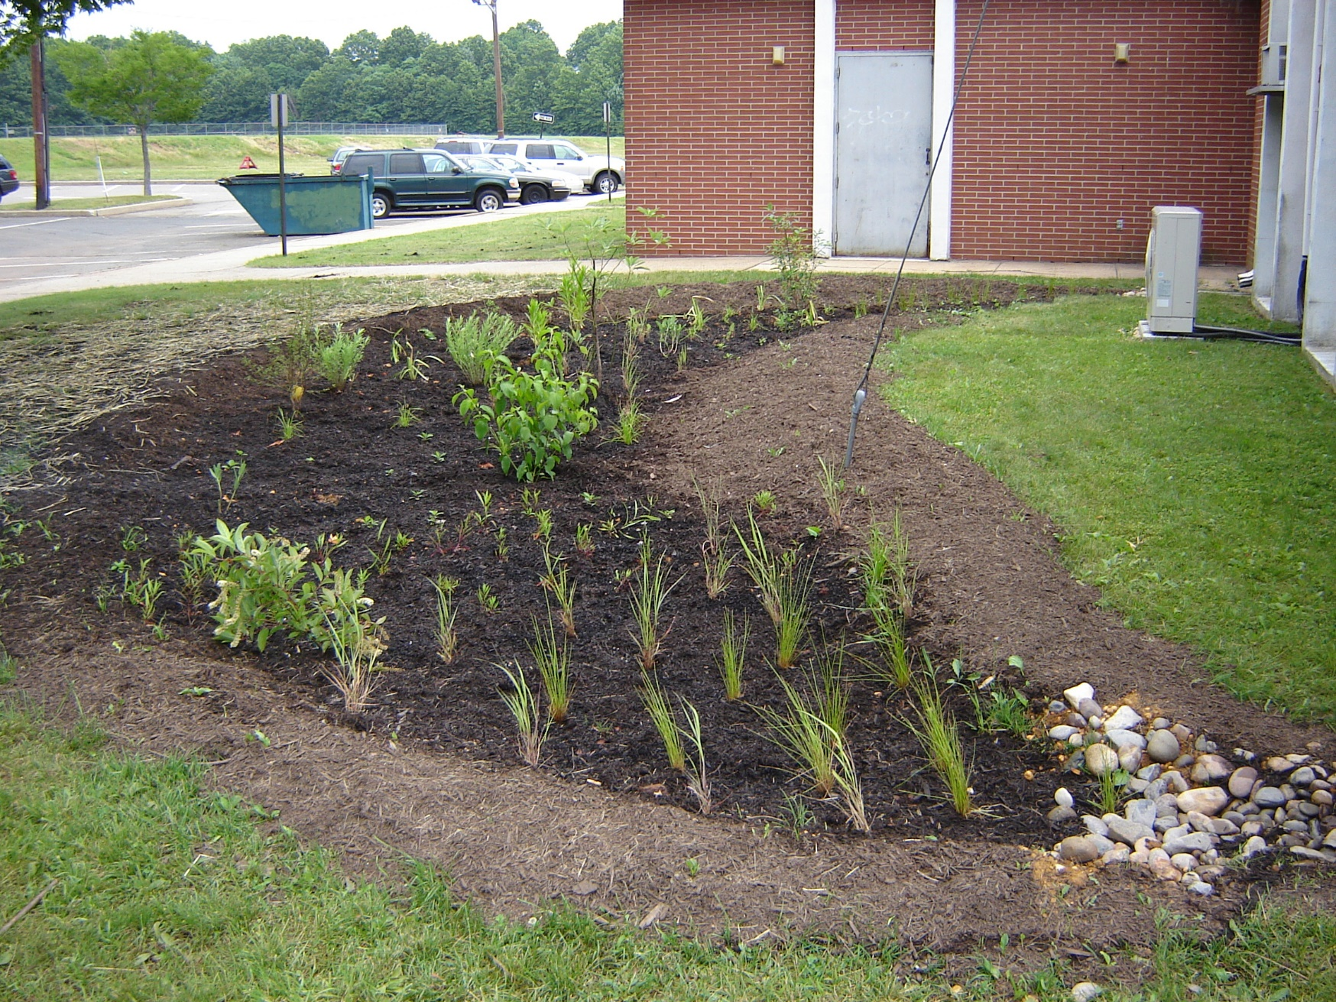
Notes:
The crescent moon rain garden at the Woodbridge Health Department

Slide 13
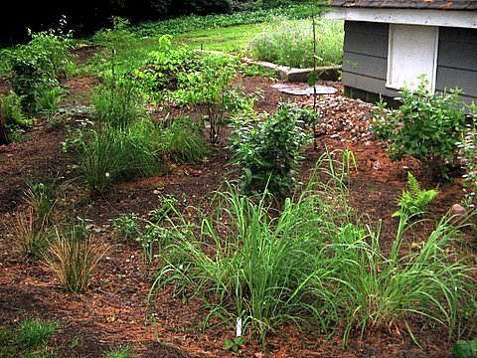
Notes:
A shady area can be perfect for a rain garden.

Slide 14
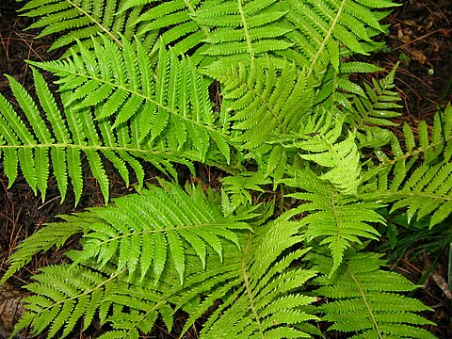
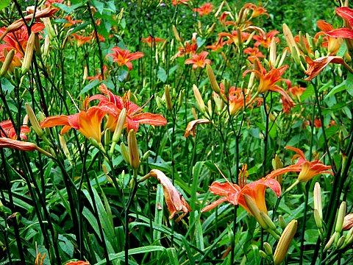
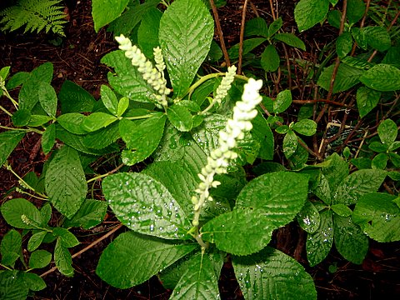
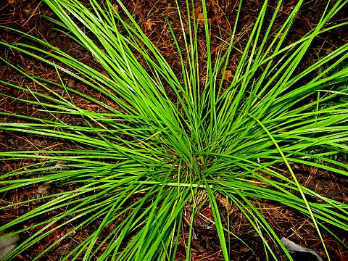
Notes:
More native plants.

Slide 15
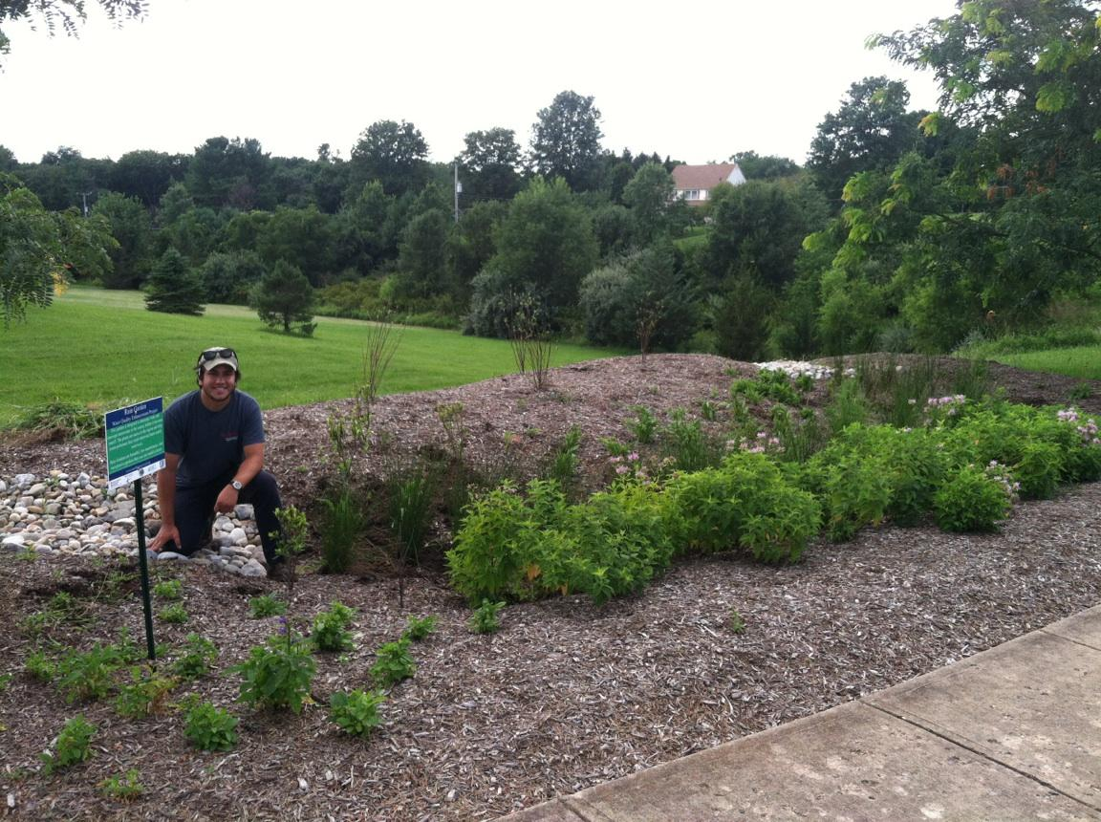
Notes:
Provides wildlife habitat

Slide 16
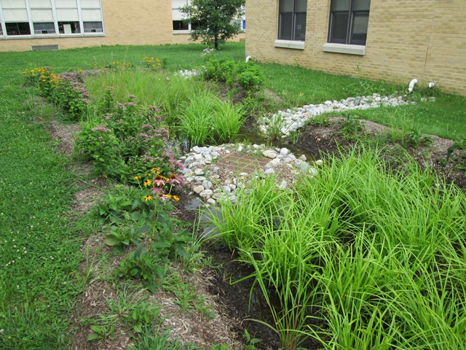
Notes:
Are more aesthetically pleasing than conventional detention basins

Slide 17
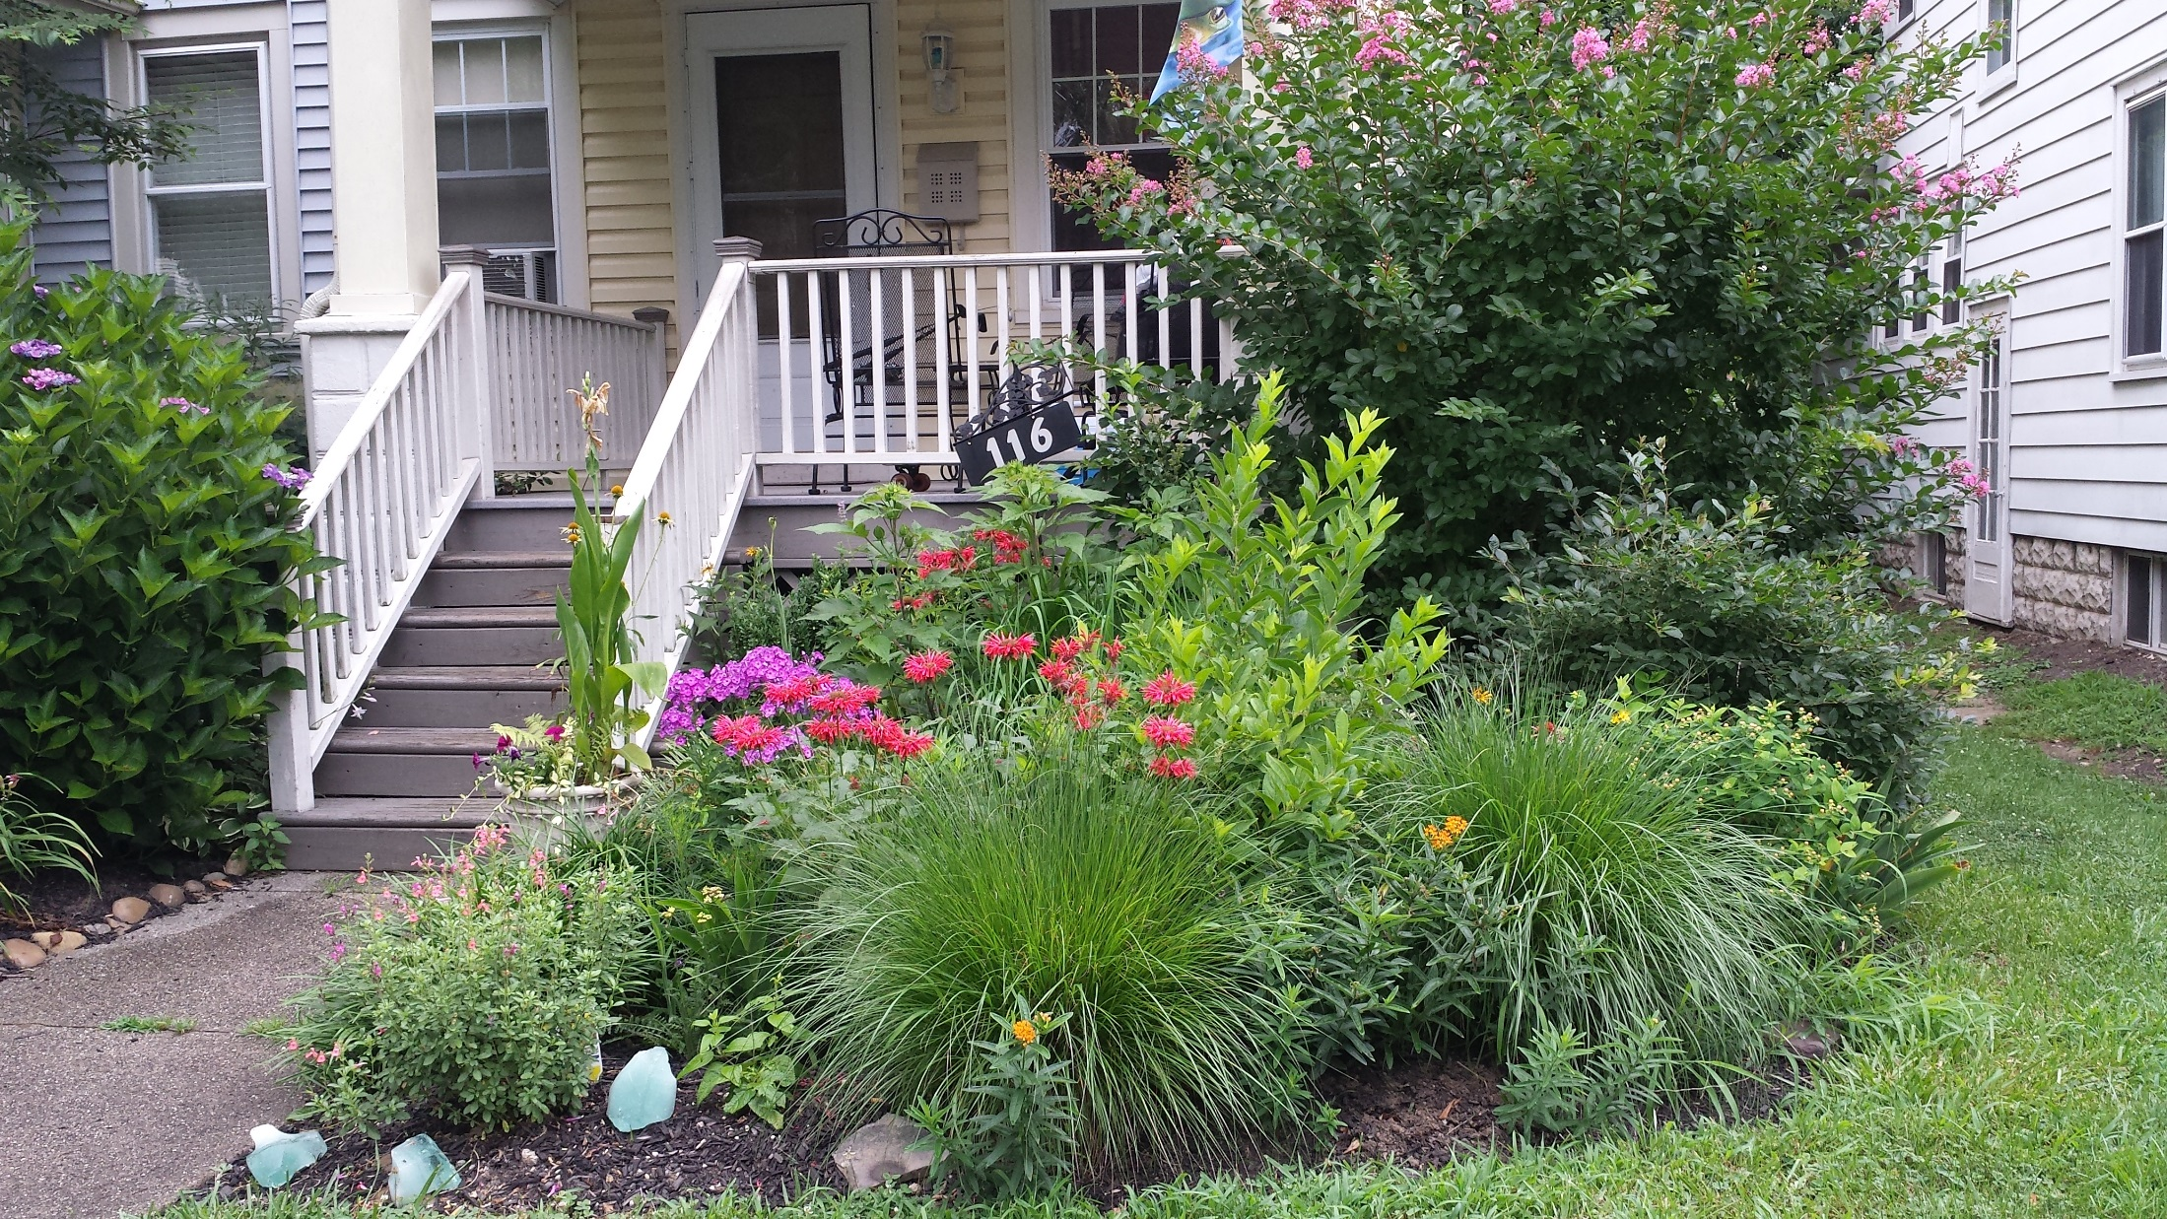
Notes:
Can be incorporated into the landscapes of individual homes

Slide 18
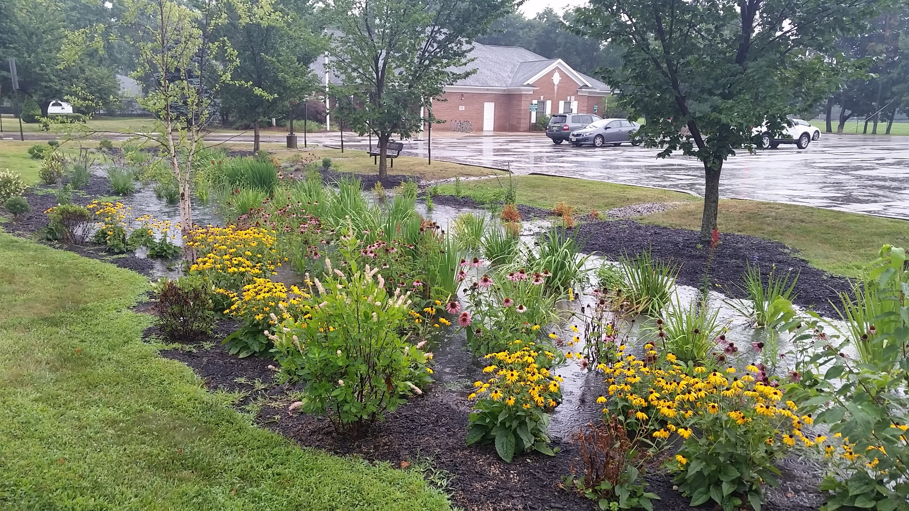
Notes:
Sequesters carbon – nice addition to the parking lot

Slide 19
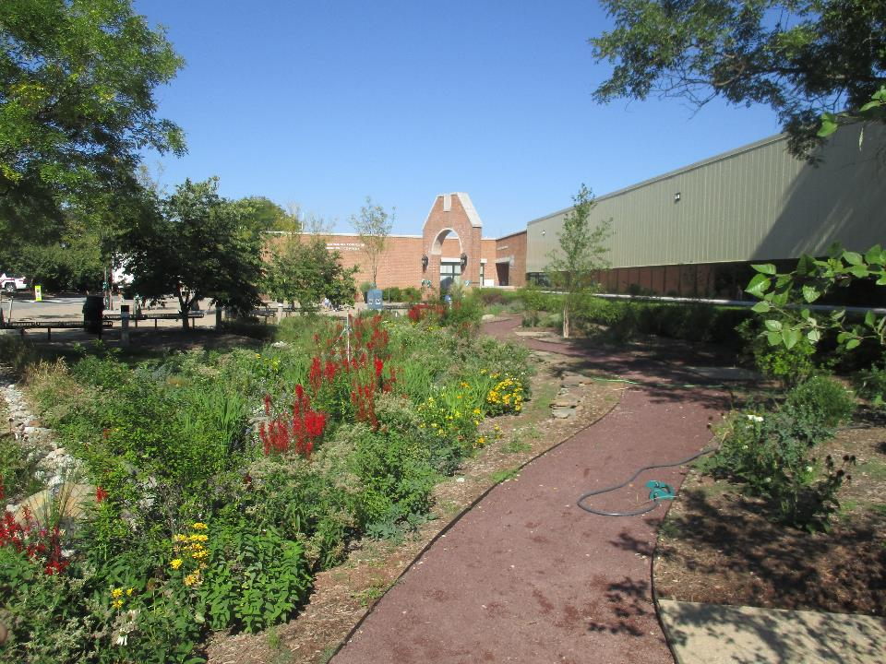
Notes:
Rain garden at the Hillsborough Municipal Building

Slide 20

Here is the website for the rain garden manual: http://www.water.rutgers.edu/Rain_Gardens/RGWebsite/RainGardenManualofNJ.html
Notes:
We have a rain garden manual that is available for download from our website.

Slide 21

Notes:
We worked with UCONN to develop a rain garden app for New Jersey.

Slide 22
Christopher C. Obropta, Ph.D., P.E.
E-mail: obropta@envsci.rutgers.edu www.water.rutgers.edu

